Slide 1
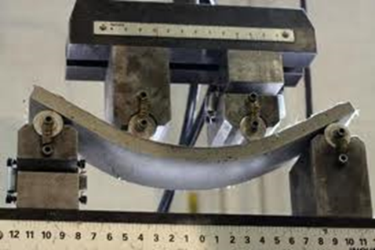
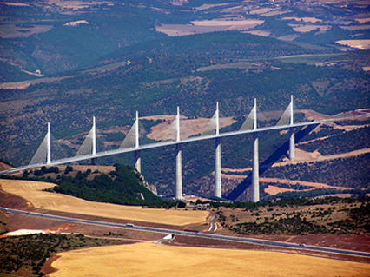
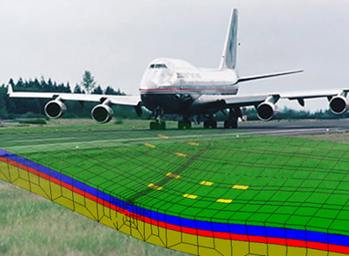
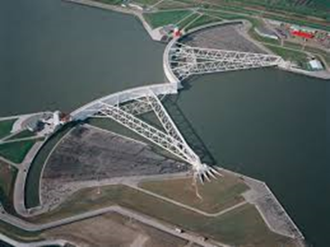
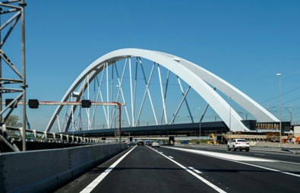
MSc track
Structural Engineering
Lambert Houben

Slide 2
MSc thesis topics
Structural Engineering thesis topics:
Most MSc theses (> 70%) done in cooperation with external party (institute, consultancy firm, contractor, manufacturer)
How to find thesis topic:
. Every Group has topics on the shelf (see later)
. External party can suggest topic
. Student can suggest topic (based on e.g. courses, internship,
actual subjects)
In last 2 cases prior TU approval required

Slide 3
MSc thesis topics
Where to find TU Structural Engineering thesis topics:
Structural Mechanics:
Brightspace pages ‘Dynamics of Solids and Structures’ and ‘Section Offshore
Engineering’; contact persons
Materials and Environment:
Contact persons
Concrete Structures:
Website TU Delft, Concrete Structures, Education, Master, MSc thesis,
Available MSc thesis topics; contact persons
Steel, Timber and Composite structures:
Contact persons
Road and Railway Engineering:
Contact persons
Hydraulic Structures:
Contact person

Slide 4
MSc thesis contact persons
Contact persons:
Structural Mechanics:
Pierre Hoogenboom, Max Hendriks, Karel van Dalen, Apostolos
Tsouvalas
Materials and Environment:
Guang Ye, Oguzhan Copuroglu, Branco Savija
Concrete Structures:
Mladena Lukovic, Yuguang Yang
Steel, Timber and Composite structures:
Roland Abspoel, Marko Pavlovic, Geert Ravenshorst
Road and Railway Engineering:
Xueyan Liu, Lambert Houben, Valeri Markine
Hydraulic Structures:
Kristina Reinders

Slide 5
MSc thesis committee
Thesis Committee:
» 3 TU staff members, divided over » 2 groups
If applicable: » 1 external member
TU Chairman
Assistant / Associate / Full professors, lecturers
PhD students under certain conditions
Since September 1, 2018 full professor not required
But still in many cases: full professor is chairman
Rules and Guidelines Board of Examiners, 2019-2020, Master of Science Civil Engineering and Applied Earth Sciences, Article 23
www.tudelft.nl / student portal / CEG / Regulations archive MSc / Educational Rules and Regulations

Slide 6
MSc thesis procedure
Procedure thesis:
2-4 weeks after start: kick-off meeting with complete thesis committee
Every 6-8 weeks progress meeting with complete thesis committee
In between especially contact with (TU or external) daily supervisor
Green light meeting:
. Final draft thesis report accepted
. Date for presentation fixed
- Final report check for plagiarism and then upload to Repository
Presentation thesis and (normal or Cum Laude) diploma awarding (all other study subjects completed at latest 5 days before)

Slide 7
MSc thesis formalities
Formalities:
CIE-1: approval start MSc thesis, chairman thesis committee, => SPA-CiTG@tudelft.nl, requirement » 65 ECTS
CIE-2: around start MSc thesis, approval complete MSc study + thesis committee, => graduation coordinator, => SPA-CiTG@tudelft.nl
CIE-2a: changes in elective courses and/or thesis committee, => graduation coordinator, => SPA-CiTG@tudelft.nl
CIE-3: in green light meeting date for presentation fixed (» 20 working days later), request for diploma, => SPA-CiTG@tudelft.nl
CIE-0: general description of procedures completing thesis/study
www.tudelft.nl / student portal / CEG / Master / Forms Master / Civil Engineering

