Slide 1
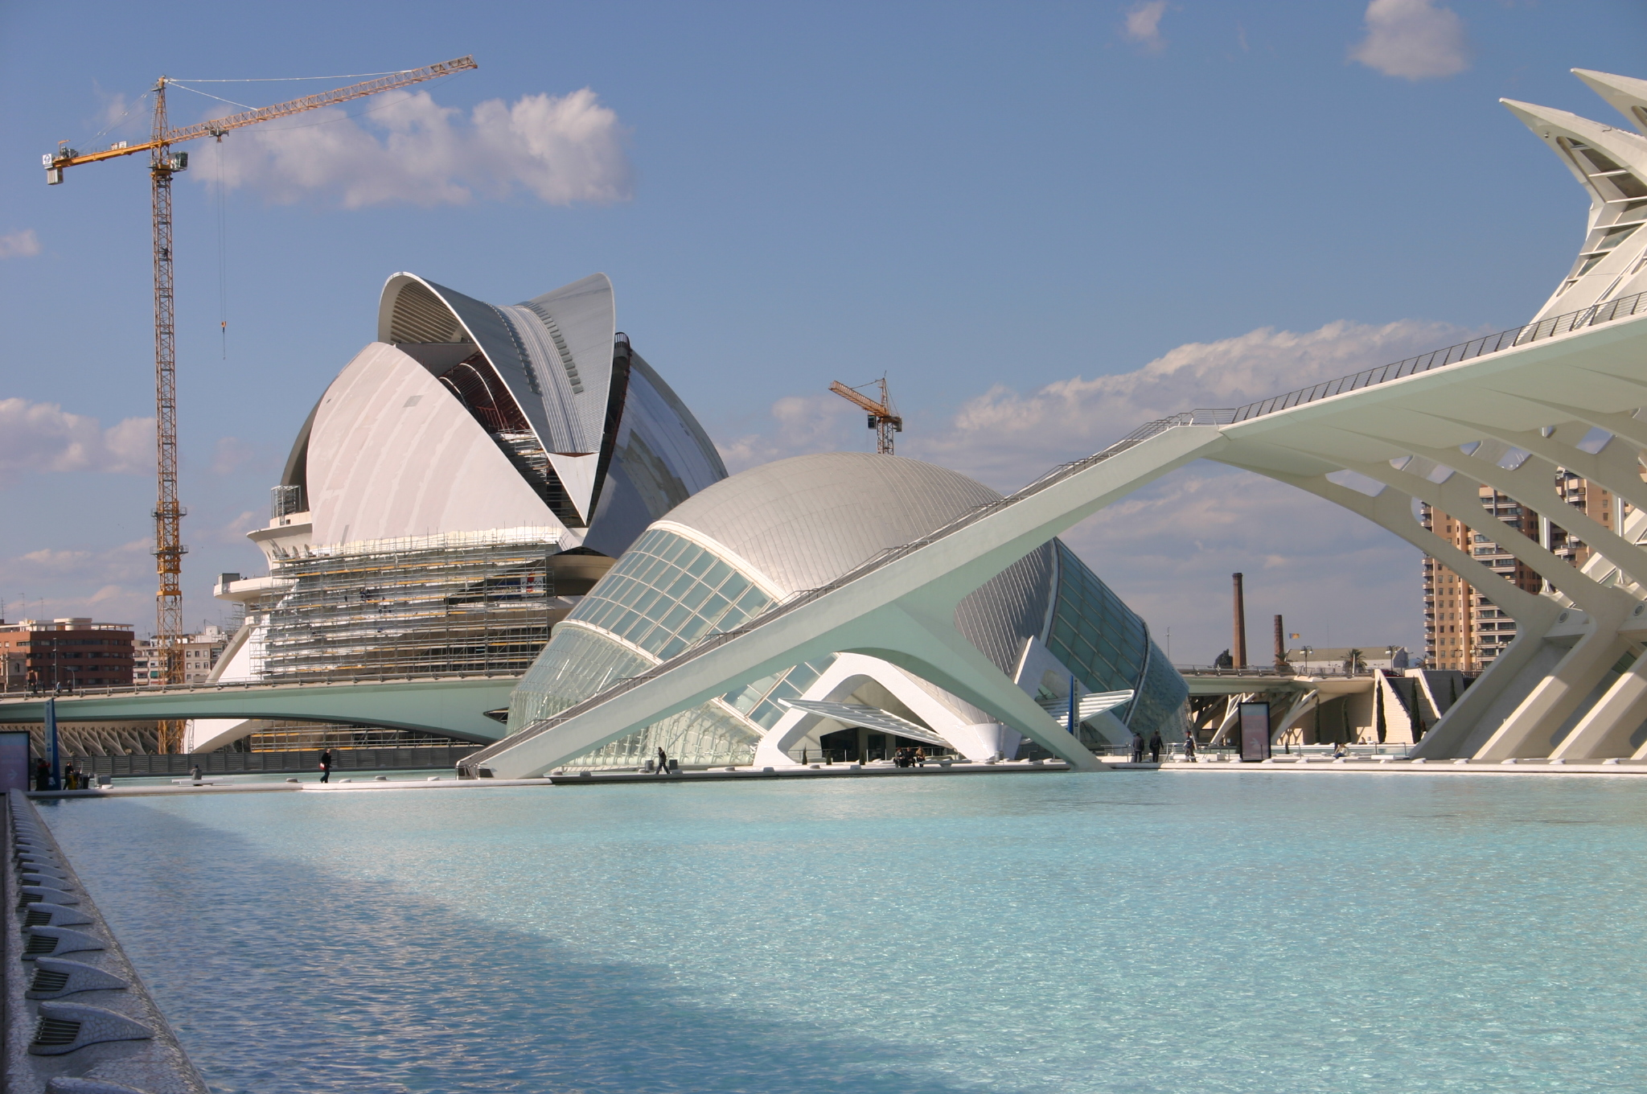
master’s thesis
Building Engineering
Notes:
What is building engineering? What challenges are we facing?
Program of building engineering
Reasons why you potentially would like to choose for the master program building engineering.

Slide 3
examples of topics
with companies

Slide 4
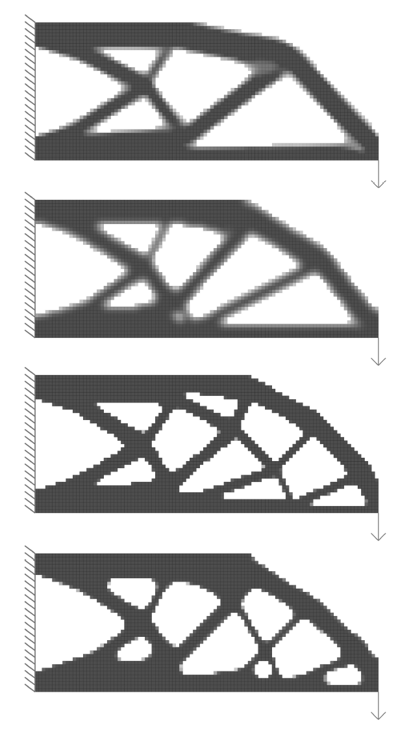

Optimising 3D Printed Concrete Structures Concrete Additive Manufacturing & Topology Optimisation
Pascal Martens

Slide 5
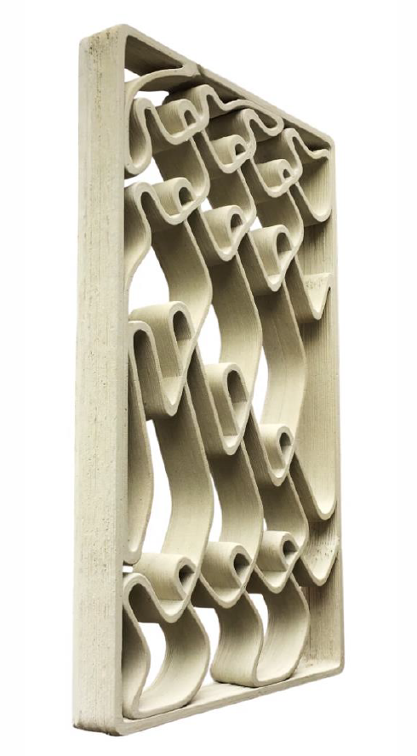


Façade Elements for 3DCP
Bram Hekker

Slide 6
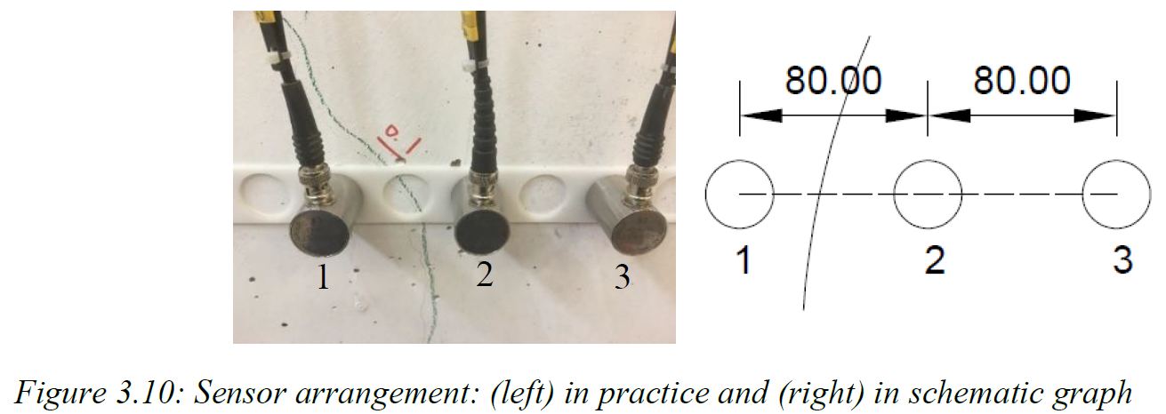
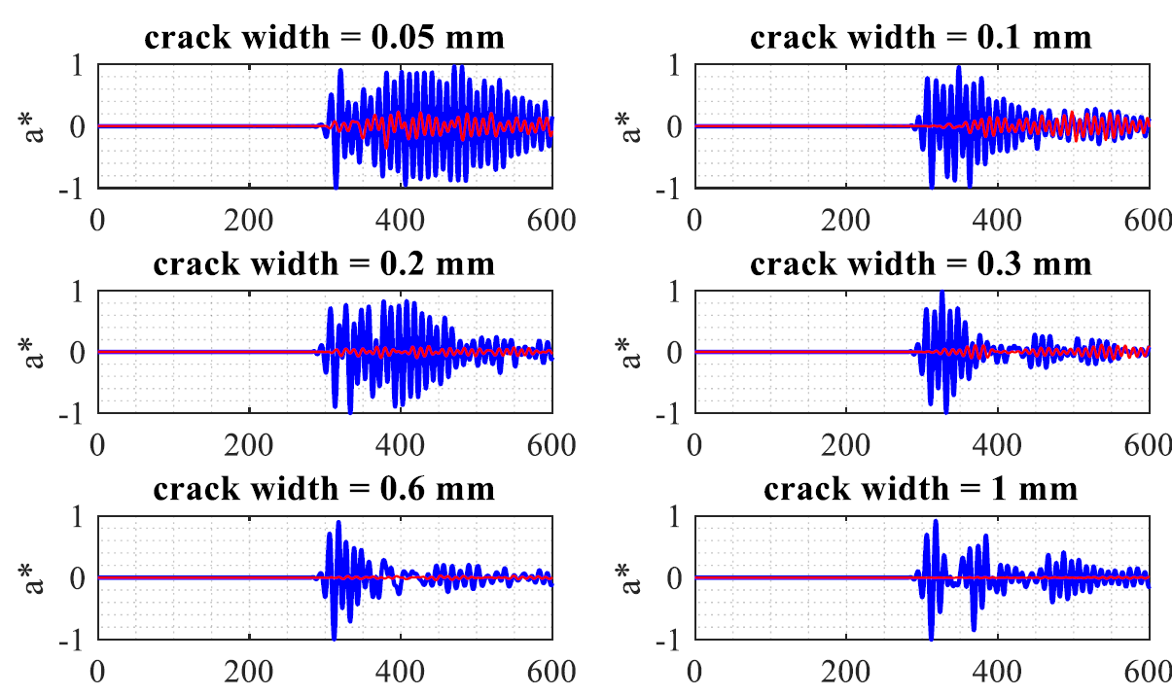

EVALUATION OF ACOUSTIC EMISSION MONITORING OF EXISTING CONCRETE STRUCTURES
Fengqiao Zhang

Slide 7


















Slide 8
examples of topics
with university

Slide 9
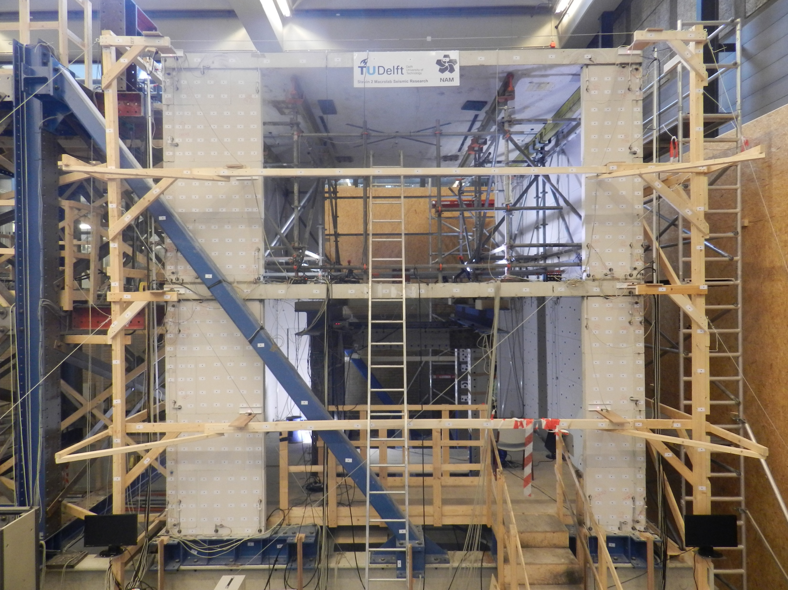

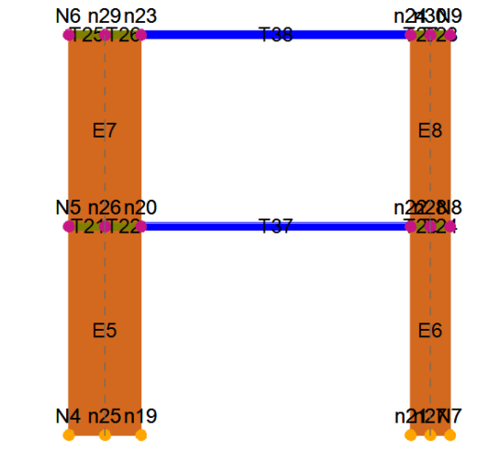

Structural assessment of a calcium silicate element masonry assemblage using an equivalent frame model
Oana Damian

Slide 10
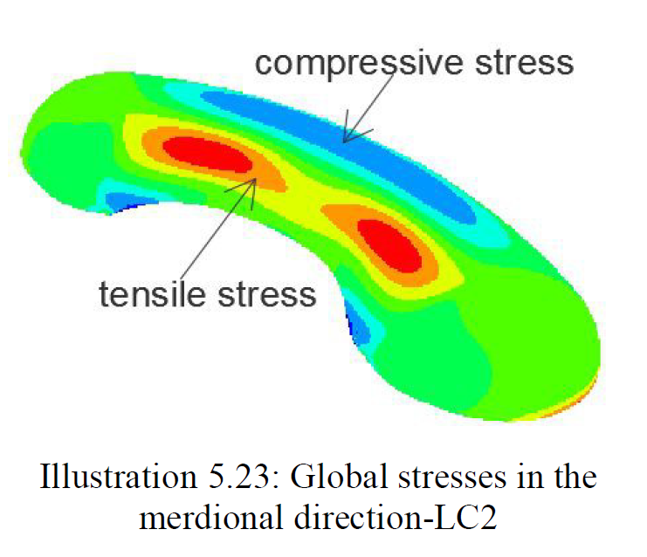
Feasibility of concrete shells using flexible mould prefabricated concrete elements
Andreas Kilimatos

Slide 11
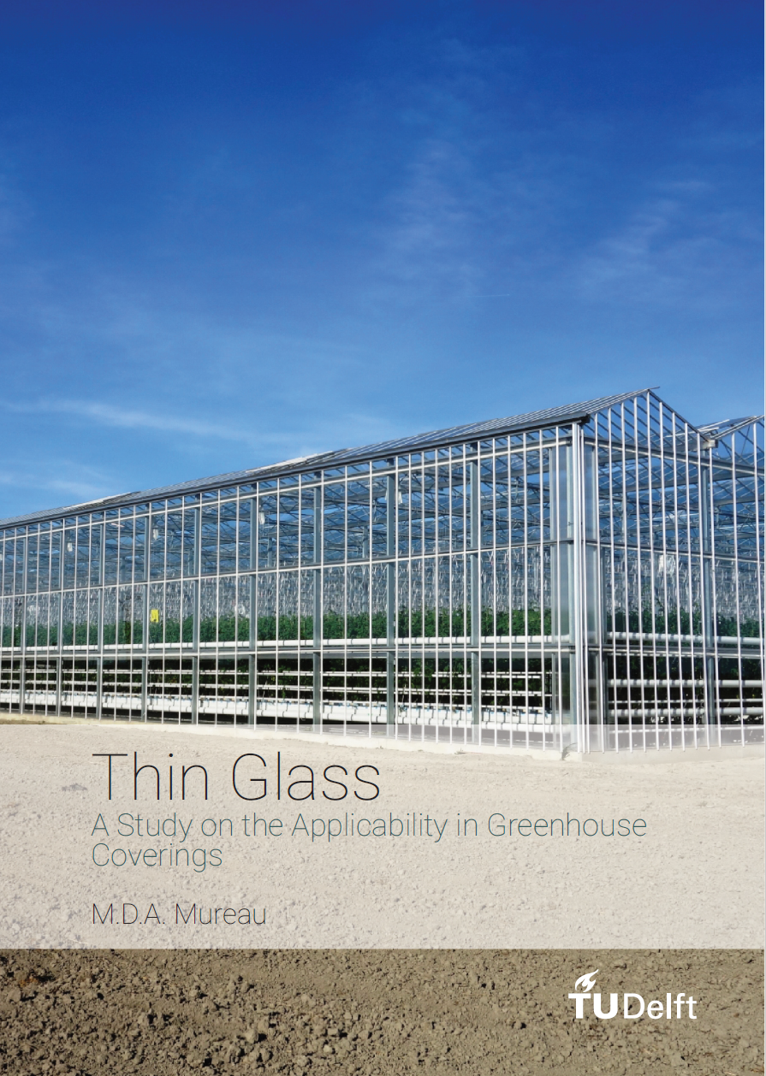
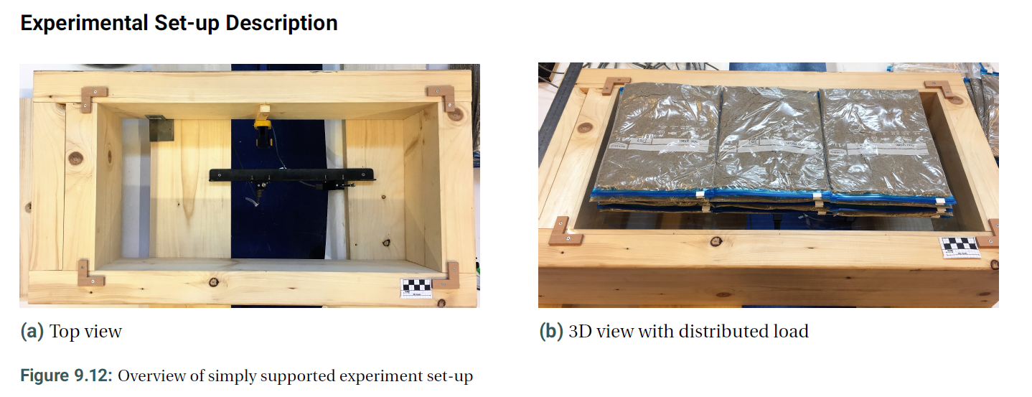
Thin Glass
A Study on the Applicability in Greenhouse Coverings
Michou Mureau

Slide 12
examples of topics
student’s initiative

Slide 13
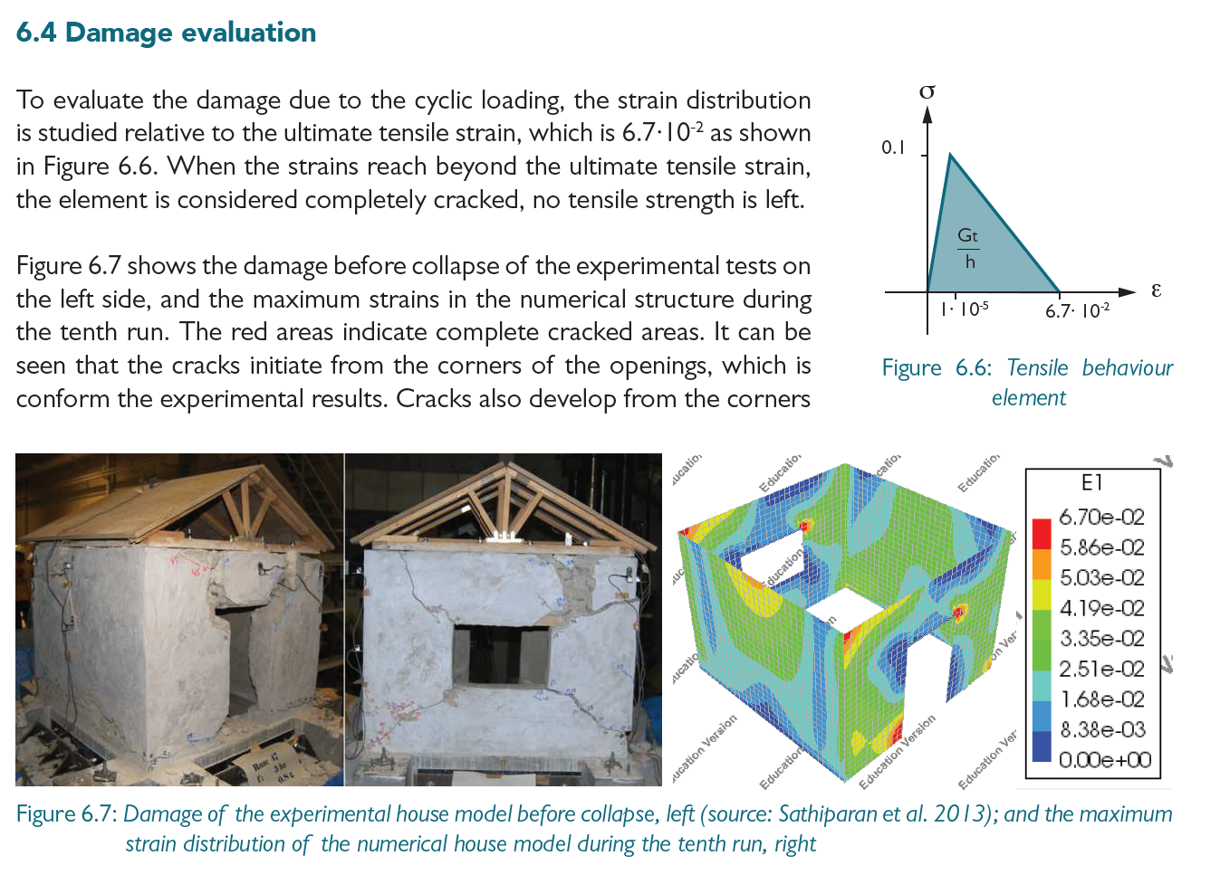
seismic assessment
of Nepali houses
Carlijn van
Hoogdalem

Slide 14
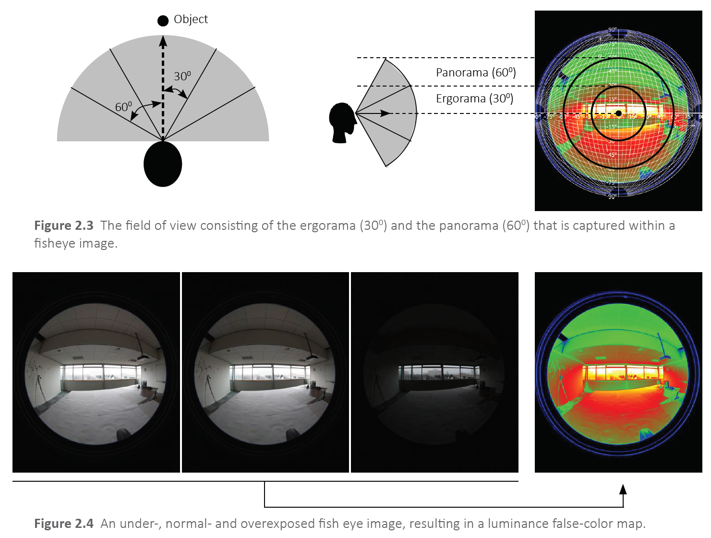
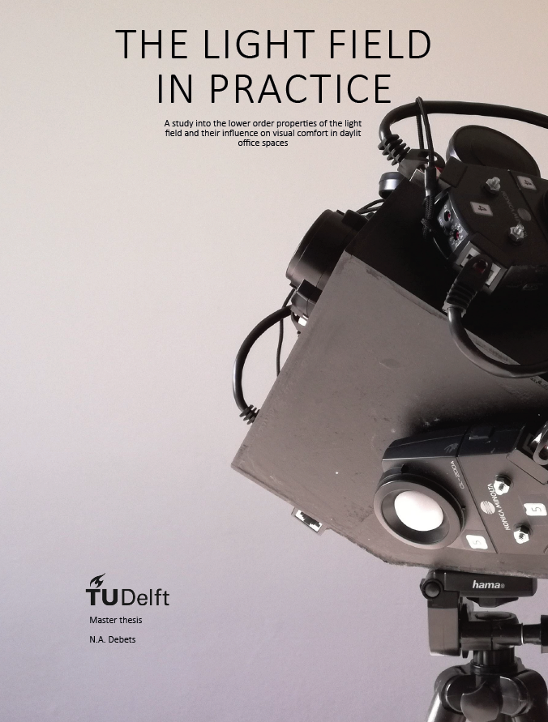
THE LIGHT FIELD IN PRACTICE
A study into the lower order properties of the light field and their influence on visual comfort in daylit office spaces
Noor Debets

Slide 15
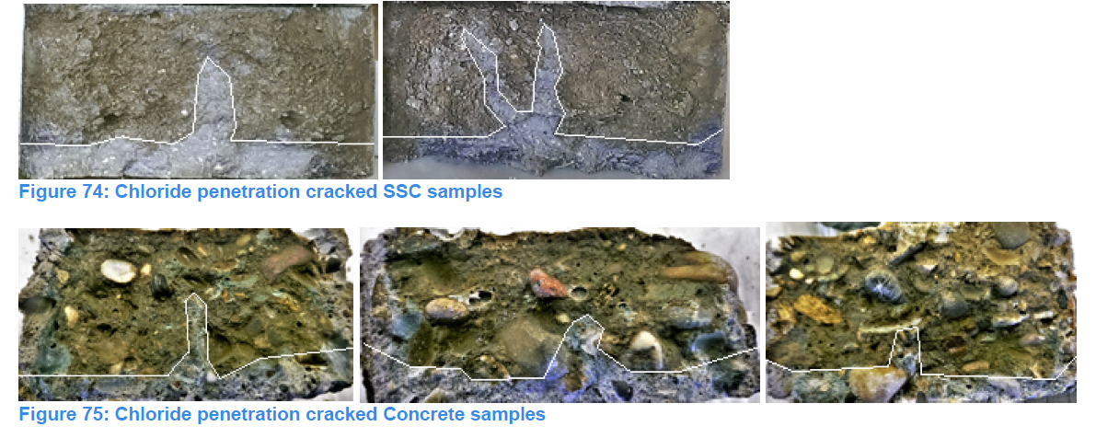
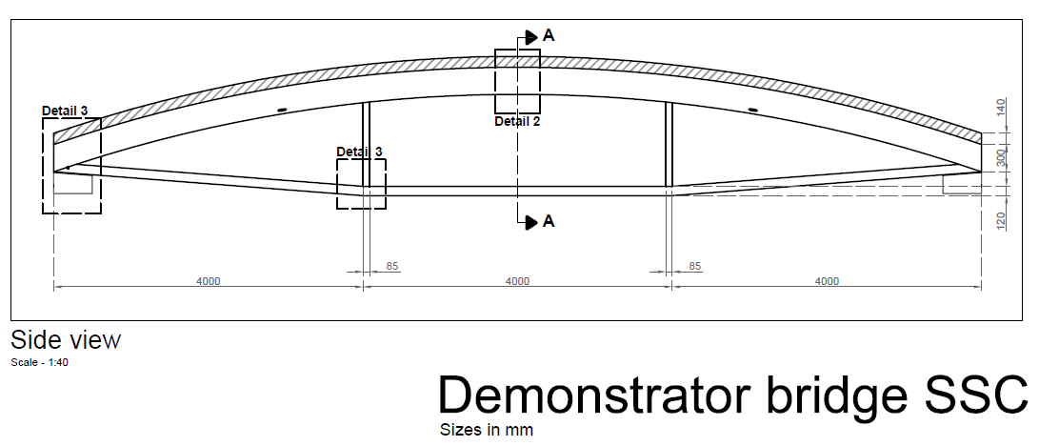
Strain hardening
Self-healing
concrete
Demonstrator
Bridge TU Delft
Charlotte Roghair

Slide 16
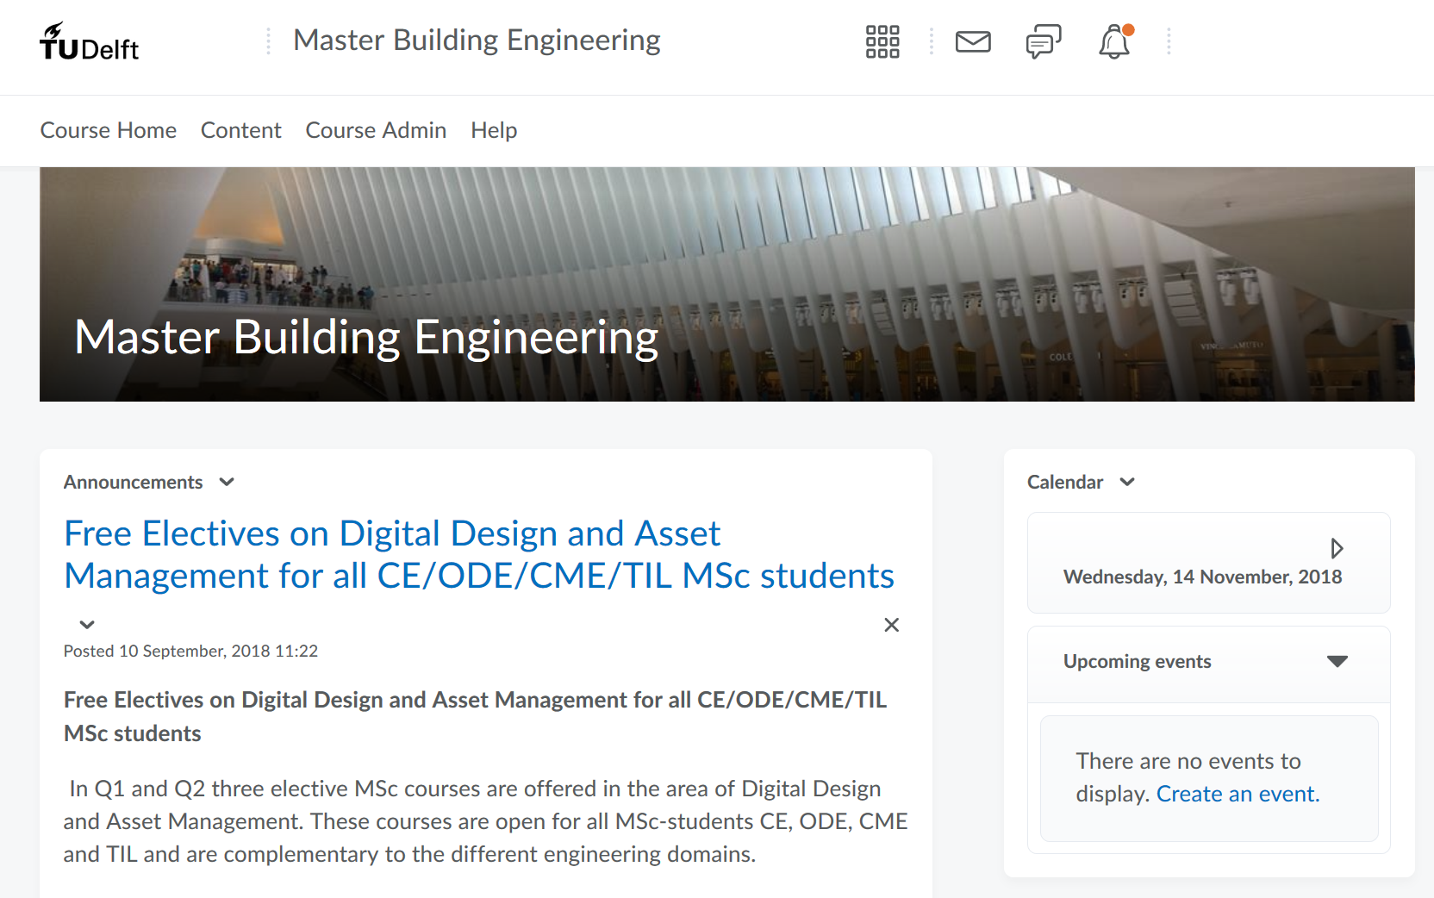

Slide 17
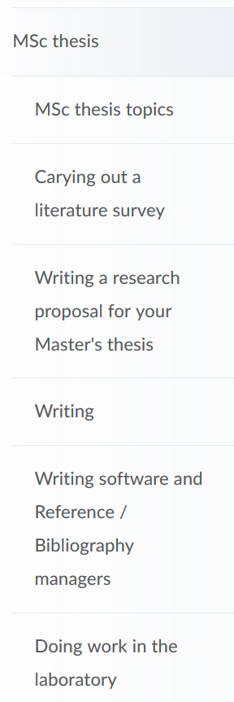

Slide 18
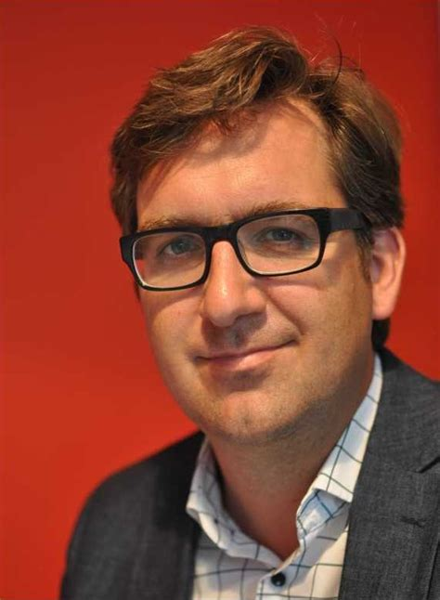






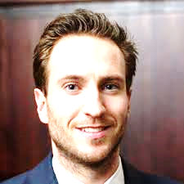

Barou
glass
Bristogianni
glass
Terwel
general structural design
safety and reliability
forensic
Nijsse
general structural design - glass
all building engineering topics
Schipper
3D-printing, façades
building physics
Pasterkamp
general structural design
structural reuse
Van der Linden
parametric design
Ham
floating homes
parametric design
Van Keulen
precast concrete

Slide 19
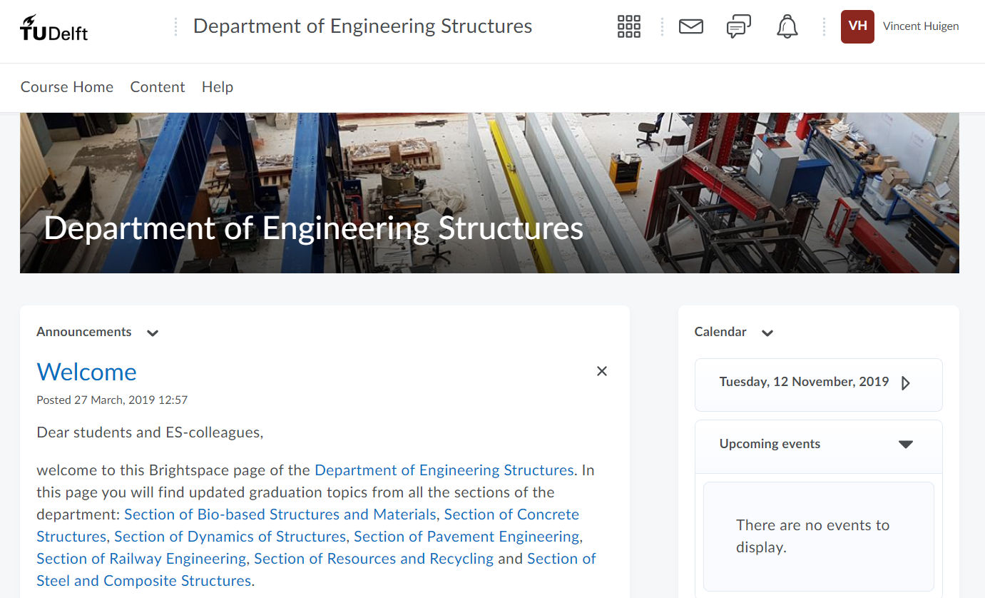

Slide 20
